Slide 1
Overview of Chef Components
Notes:
This Chef Essentials course provides a basic understanding of Chef's core components, basic architecture, commonly used tools, and basic troubleshooting methods.
This should provide you with enough knowledge to start using Chef to automate common infrastructure tasks and express solutions to common infrastructure problems.
Instructor Note: Be sure to read Appendix Z for training lab set up notes and additional instructor notes.

Slide 2
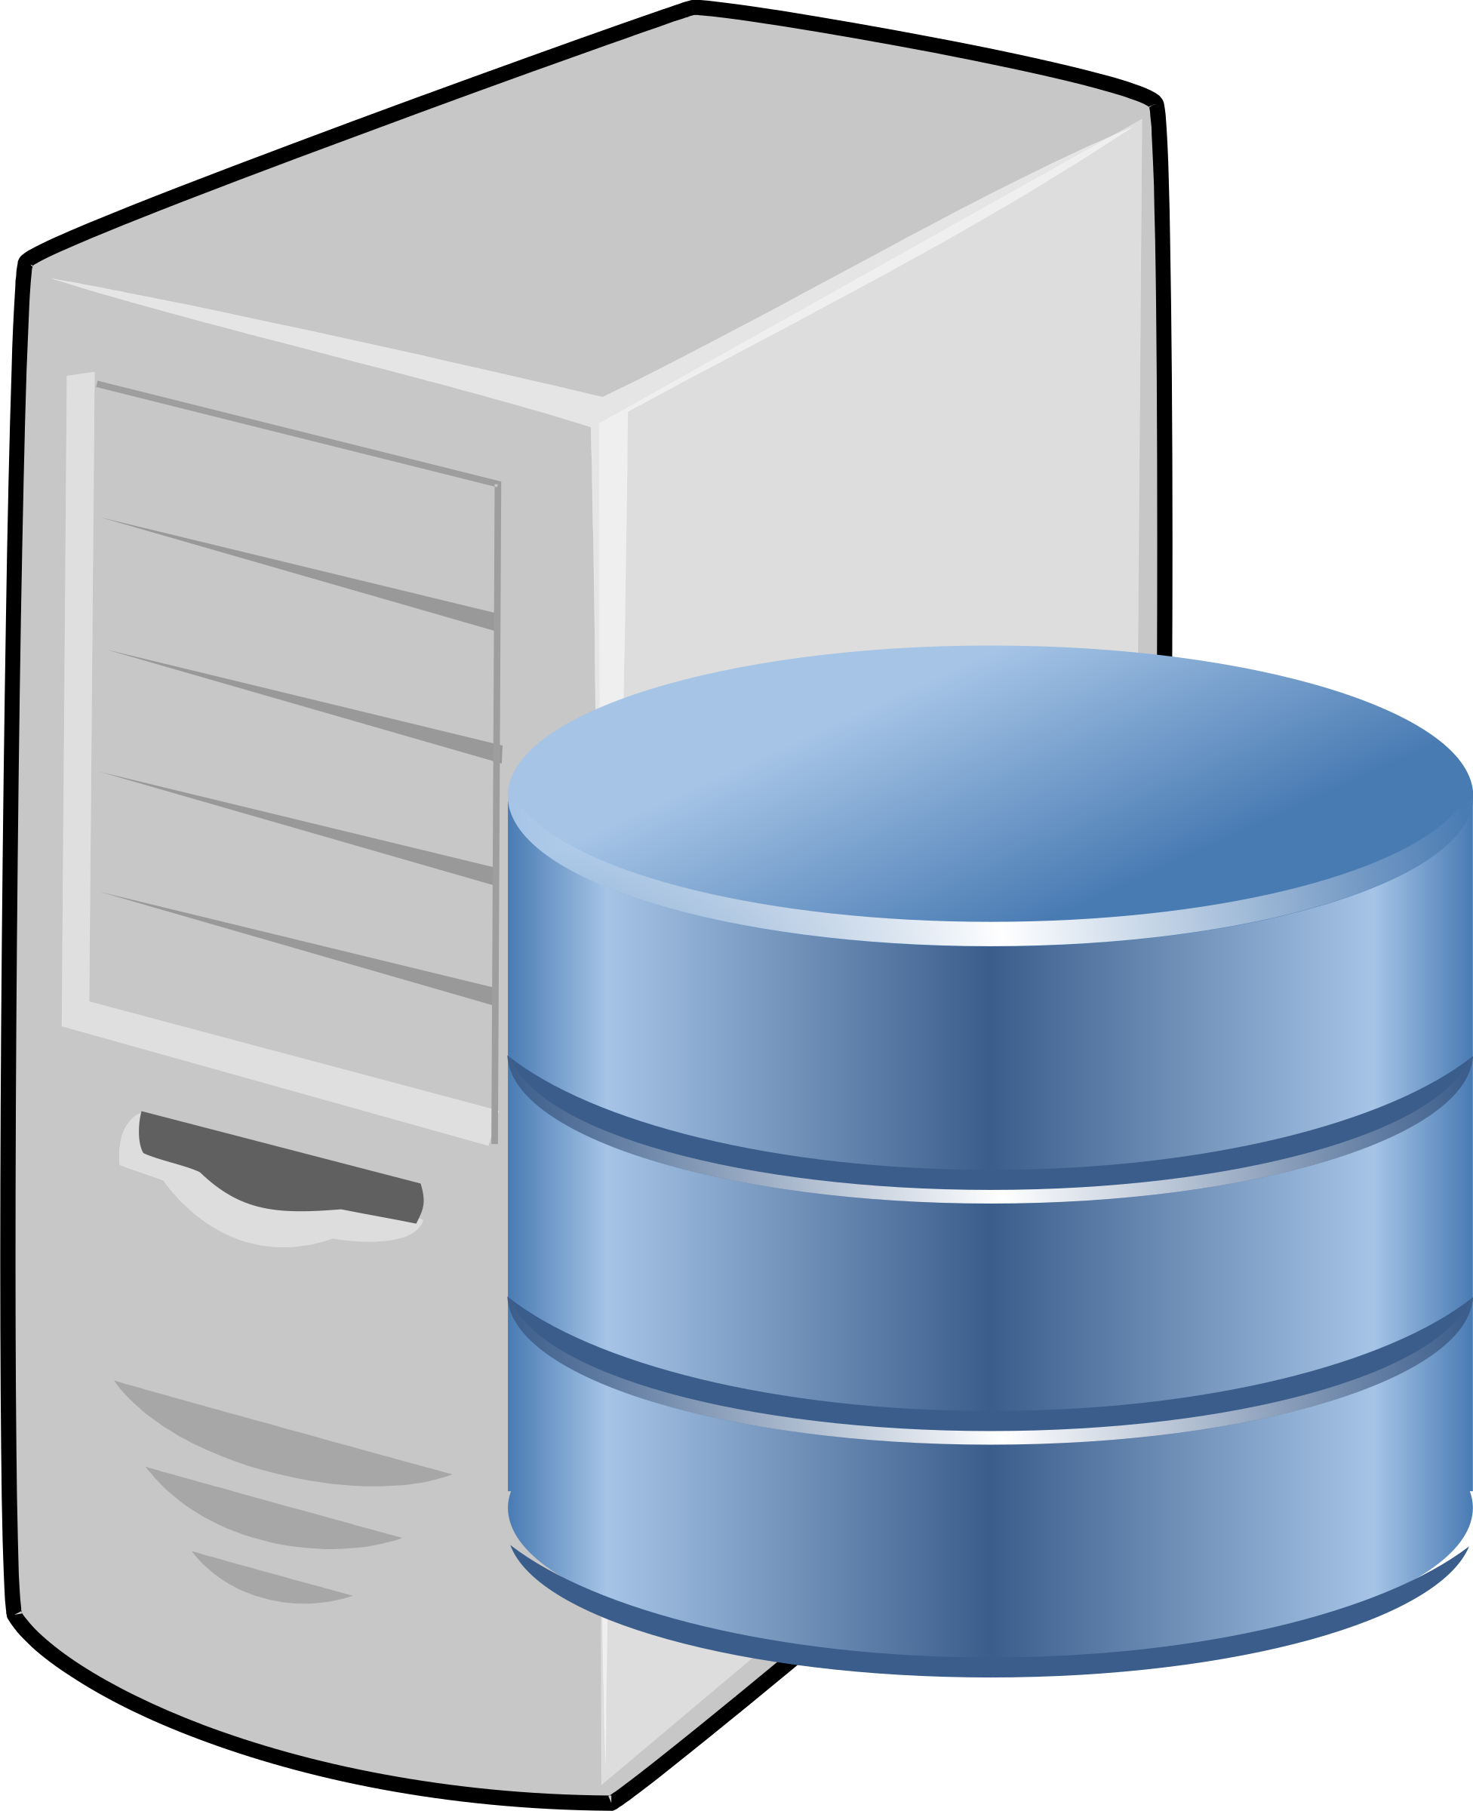
Managed Nodes
Chef Server
Recipes
Cookbooks
Resources
Notes:
Throughout this class, you will hear me mention the term resource (or resources). Resources are the basic building blocks of Chef configuration. They describe how you want your system to look. For example, if you want an application installed on all the computers on your system, then you would use a resource called package which basically starts the ball rolling to install an application package.
[CLICK] Resources are compiled into Recipes. Recipes are files written in the programming language Ruby. They always end with the file extension .rb.
[CLICK] Recipes are stored or “packaged” into Cookbooks (which are actually directories). Cookbooks describe a specific scenario. For example, if you want to set up a certain type of computer, say the load balancer we talked about earlier, then you would use a cookbook to do that. In that cookbook you would include all the recipes necessary to set up a load balancer. You would also include in that cookbook configuration files, templates, testing tools – everything you would need to set up the load balancer.
[CLICK] After you finish writing your cookbook, you upload that to the Chef Server. Usually, the Chef Server is what we call a virtualized machine (it can be a physical machine or it can be something that is hosted. Chef provides a hosting service to our clients, but they don’t necessary have to use Chef’s hosted service – they can have internal servers, they can pay for hosting from another vendor – there are a lot of possibilities).
[CLICK] Once the cookbooks have been uploaded to the Chef Server, a process called Converge happens. During this process, all the nodes that live in the cloud are brought up-to-date based upon the cookbook configuration. By default, this converge process is automated. Chef is set up so that the nodes communicate with the Chef Server every 30 minutes. However, Chef is completely customizable, so that default setting can be changed.
So, does anyone know what we call it when everything is up to date and the managed nodes have all the right cookbooks?

Slide 3
Desired state
Notes:
That’s right, we call this the desired state.

Slide 4
Managed Nodes
Chef Server
CHEF CLIENT (CONVERGE)
KNIFE
(BERKSHELF)
Recipes
Cookbooks
Resources
LOCAL WORKSTATION
Notes:
Now, back to the whole Chef Process, [CLICK] The recipes and cookbooks typically are built on your local apache.
[CLICK] You upload the cookbooks to the Chef server using a command line tool called Knife. There also is a tool called Berkshelf that is used to upload cookbooks. We’ll talk about that in more detail later in the class. Let’s just say it makes your life much much easier.
[CLICK] And as I stated earlier, the cookbooks are converged onto the nodes from the Chef Server. This is accomplished using a command line tool called Chef-Client.

Slide 5

Infrastructure as Code
Test Kitchen
Notes:
There are so many other terms we could define, but then we would be here for weeks. So, aside from what we have already talked about, there is one more term you may have heard that I want to mention, and that’s Test Kitchen. Test Kitchen really is one place where Chef shines. I fan girl over it all the time, frankly.
[CLICK] The benefit of using a configuration management tool like Chef is that infrastructure is built as code. When I first head that term, I was like “what the what?” But, 8 months later, I get it. Basically, we write Rub code into our recipes, which we compile into our cookbooks. That code describes how we want our infrastructure to look. And because it’s code, we can test it like code. That this is where test kitchen comes into play.

Slide 6


Notes:
So, if you think about it this way – our managed nodes out in the cloud are our production environment. [CLICK] This is what the rest of the world is going to see – our website/our application.
But, before we put it out there, we need to make sure that it’s going to work okay. [CLICK] We need to have a test environment. This is what test kitchen does for us. It creates the test environment that looks exactly like our production environment. Then it tests all the code in our recipes and cookbooks to make sure they do exactly what we expect them to do.
Then, we we are ready to deploy, we don’t have to worry that something will break.

Slide 7
Notes:
Okay, now we are going to move onto playing with some of the chef tools. Before we do that, let’s go ahead and take break. Process all that covered and when we come back we’ll have a brief Q/A period and then jump into playing with Resources, recipes and cookbooks!

